Slide 1
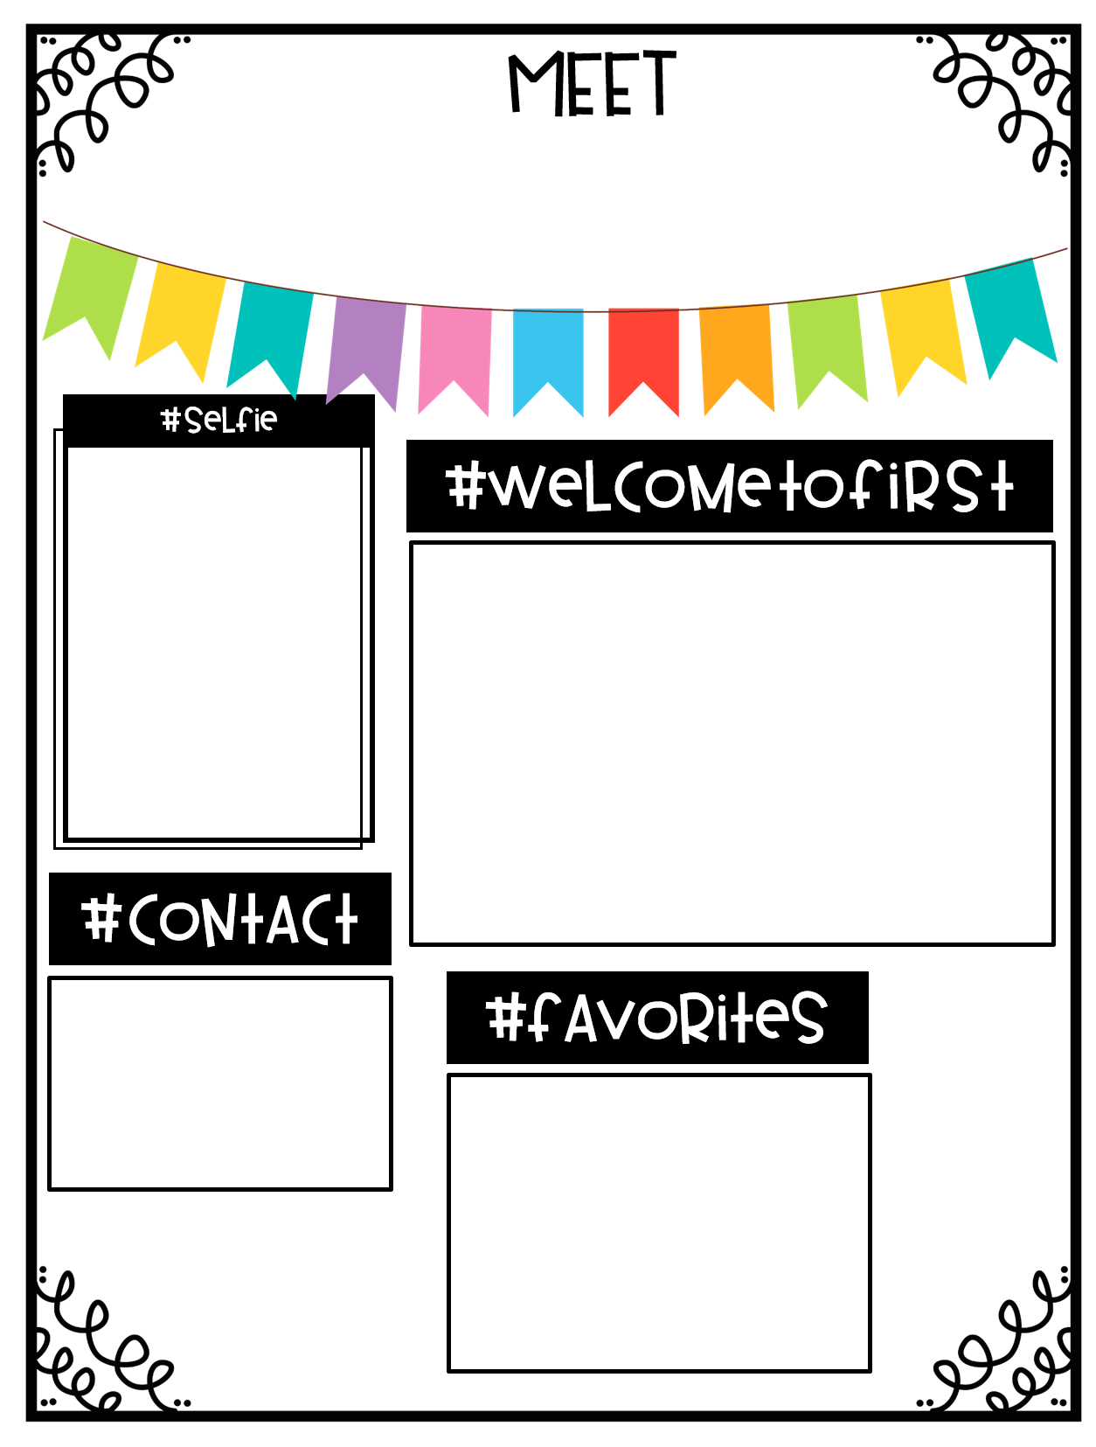
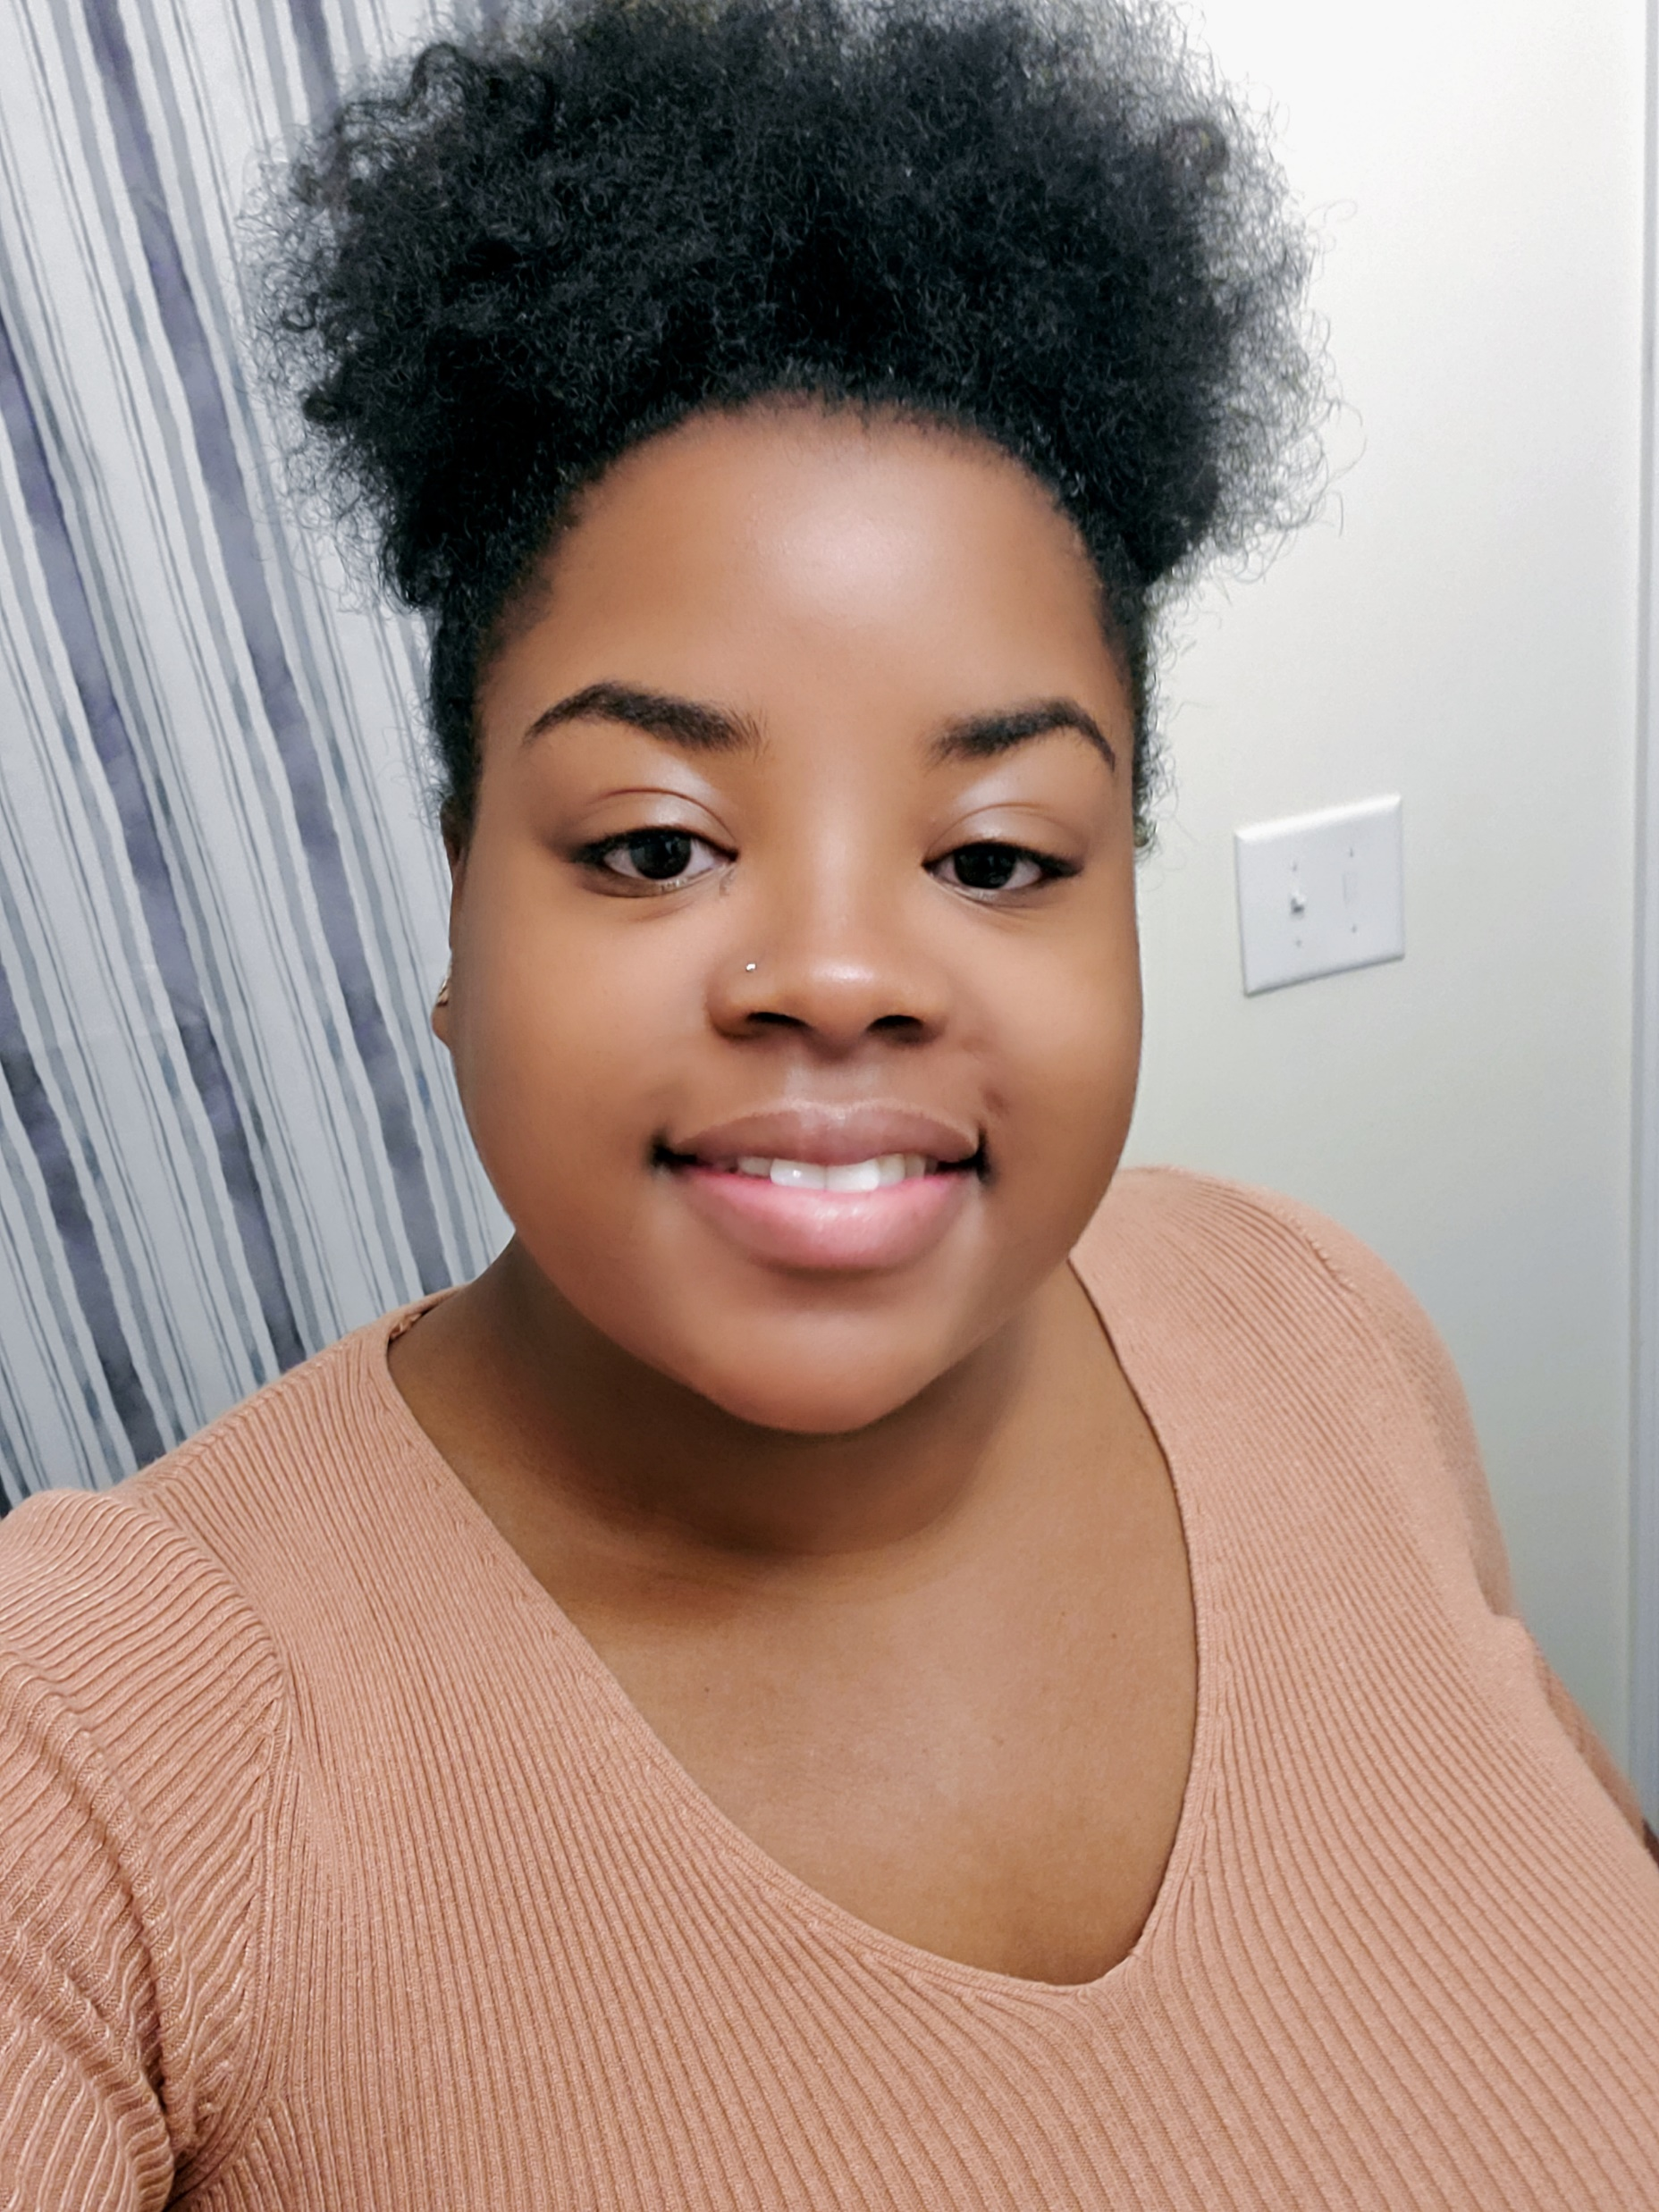
Ms. Elam
Hi, I am Ms. Elam, and I will be your child’s first grade teacher. Before becoming a teacher, I was a Special Education Paraprofessional here at Hains. I was born and raised in Augusta, Ga. After graduating high school, I went off to college and earned my bachelor’s degree in Sociology. I am currently working on my Masters. I decided to teach because I love children and I want to help them reach their goals. I am so excited to teach your child this year. Expect them to laugh and to have fun.
Phone:
(706) 796-4918
Email:
ElamDa@BOE.Richmond.k12.ga.us
Color: Red and Black
TV show: First 48
Food: Pizza
Candy/Chocolate: Now and later & Hershey’s with almonds

